Slide 1



Slide 2



Slide 3
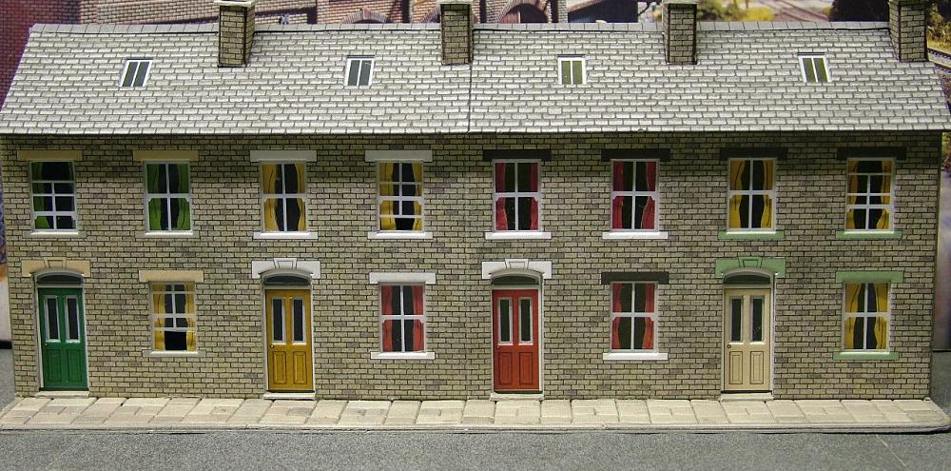


Slide 4
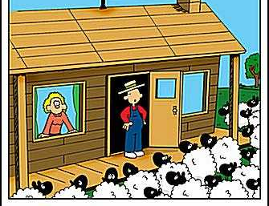


Slide 5



Slide 6

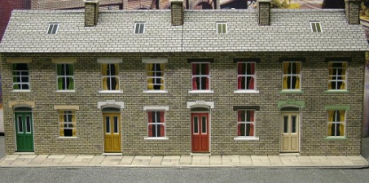
1.
2..
http://www.s-cool.co.uk/topic_quicklearn.asp?loc=ql&topic_id=3&quicklearn_id=1&subject_id=25&ebt=&ebn=&ebs=&ebl=&elc=
3.
4.
5.

